Slide 1
Test Design Techniques
2025
Poornima

Slide 2
What is Test Design Technique?
The Test Case Design Technique creates test cases by identifying different input combinations and outputs to evaluate software system functionality.
Used for deriving test cases and optimizing test data during SWT.
Example:
If you want to test a login feature, you might use Equivalence Partitioning to create test cases with valid usernames and passwords, which is one partition, and invalid ones will be another partition to check how the system reacts in different situations.

Slide 3
Types of Test Design Techniques
Equivalence Partitioning
Boundary Value Analysis
Decision Table
State transition testing
Use case testing
Error Guessing
Exploratory testing
Statement Coverage
Path Coverage
Branch Coverage
Condition coverage
Blackbox
Experienced Based
White box/
Structure Based

Slide 4
Top Test Design Techniques in Software Testing
Equivalent Class Partitioning
Boundary Value Analysis
State Transition Testing
Pairwise Testing
Error Guessing
Statement Coverage
Decision Coverage
Data Flow Testing
Path Testing

Slide 5
Importance of Test Design Techniques in Software Testing
Early identification of defects
Systematically designed tests can help to uncover critical issues before release.
Enable automation
It provides a structured framework for automating test cases, allowing for efficient execution of repetitive tests.
Identify edge cases
By using boundary value analysis, you can identify crucial issues at the limits of input values.
Better collaboration
Clear test documentation based on design techniques helps improve communication between testers, developers, and products.

Slide 6
Equivalence Class Partitioning (ECP)
Involves dividing input data into partitions or classes, where all the data in each partition is expected to behave similarly
This technique allows you to test one representative value from each partition instead of testing every possible input
Example:
Imagine testing an input field that accepts age values between 1 and 100. With equivalence partitioning, you could break this range into three partitions:
Values below 1 (invalid inputs)
Values between 1 and 100 (valid inputs)
Values above 100 (invalid inputs)
Testing one value from each partition, such as 0, 50, and 101, would ensure coverage of all relevant scenarios without overburdening the testing process.
Benefits:
Reduces the number of test cases by grouping similar inputs.
Ensures broad coverage with minimal test duplication.
Easy to implement and effective for most input-based systems.

Slide 7
Boundary Value Analysis (BVA)
Focuses on the "boundaries" of input data. Min, max, min-1, min+1, max+1, max-1
Most systems are more likely to fail at the edges of input ranges, so BVA tests these critical points.
When applied in combination with equivalence partitioning, it provides an extensive understanding of system behavior at input boundaries.
Example:
Consider a function that accepts values from 1 to 100. BVA would test at the boundaries: 0, 1, 2,99, 100, and 101. This helps to catch errors that occur when transitioning between valid and invalid input values.
Benefits:
Highly effective in catching edge-case bugs.
Minimizes test cases while focusing on critical areas.
Helps uncover unexpected behaviors at data limits.

Slide 8
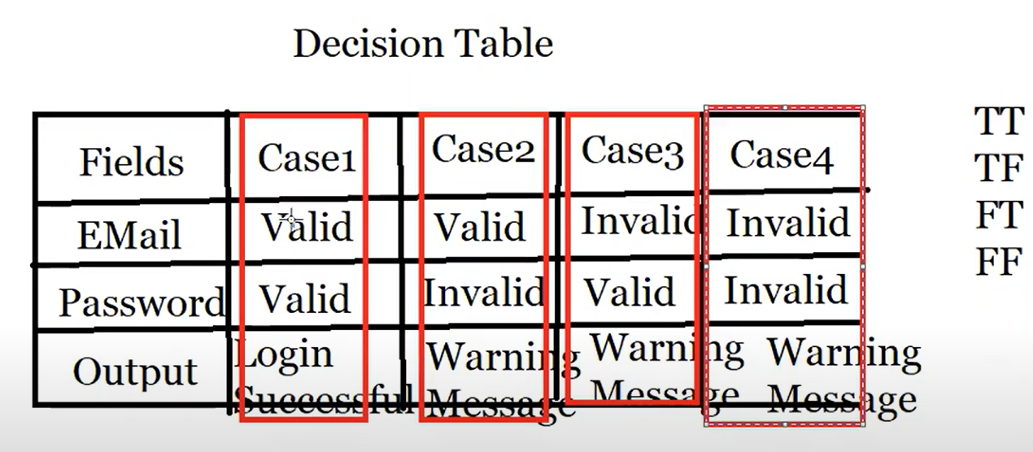
Decision Table
This is a structured technique that documents different input combinations and their corresponding system outputs in a tabular format. This method is ideal for testing applications with complex business logic or multiple rules and conditions. The table consists of conditions and actions, where each combination of conditions represents a unique test case.
Example:
Benefits:
Provides a clear and systematic approach to testing complex logic.
Ensures all possible combinations of inputs are tested.
Easy to understand and document, making it a great communication tool for stakeholders.

Slide 9
State Transition
State Transition Testing is ideal for applications where the system's behavior changes based on its current state.
This technique involves designing test cases around state changes and the transitions between states. For example, a user login system could have states like "logged in," "logged out," or "locked out" after multiple failed login attempts.
Example:
Scenario:
Login system → 3 failed attempts → account locked; Successful login resets counter.
Example transitions:
Start → Fail → Fail → Fail → Locked
Start → Fail → Success → Reset to Start
Locked → Wait 30 min → Unlocked
Benefits:
Excellent for testing systems with dynamic state changes.
Ensures that all valid and invalid state transitions are tested.
Helps identify unexpected or incorrect state transitions.

Slide 10
Error Guessing
Error guessing is a technique in which professional testers use their knowledge and experience to figure out where errors are likely to be found.
However somewhat less calculated than some of the methods explained above, error guessing can be very useful when utilized by trained testers who are knowledgeable about are familiar with software risks.
Example:
A tester familiar with common errors in web forms might specifically test for issues like submitting the form with invalid data, missing mandatory fields, or injecting special characters to see how the system handles it.
Benefits:
Leverages tester expertise to find hidden issues.
Often uncovers defects that formal methods miss.
Complements other testing techniques by filling in gaps.

